Slide 1

Chetan Gowda 2025

Slide 2

Outline
EXECUTIVE SUMMARY
INTRODUCTION
METHODOLOGY
RESULTS
CONCLUSION
APPENDIX
2

Slide 3
Executive Summary
Summary of methodologies
-Data collection
-Data wrangling
-EDA with data visualization
-EDA with SQL
-Building an interactive map with Folium
-Building a Dashboard with Plotly Dash
-Predictive analysis (Classification)
Summary of all results
-Exploratory data analysis results
-Interactive analytics demo in screenshots
-Predictive analysis results
3

Slide 4

Introduction
Project background and context:
We will predict if the Falcon 9 first stage will land successfully. SpaceX advertises Falcon 9 rocket launches on its website, with a cost of 62 million dollars; other providers cost upward of 165 million dollars each, much of the savings is because SpaceX can reuse the first stage. Therefore, if we can determine if the first stage will land successfully, we can determine the cost of a launch. This information can be used if an alternate company wants to bid against SpaceX for a rocket launch
Problems you want to find answers
What factors a successful rocket landing?
The correlation of rocket variables with the success rate of a rocket landing.
What conditions does SpaceX have to achieve to ensure the highest success rocket landing rate.
4

Slide 5

Section 1
5

Slide 6
Methodology
Data collection methodology:
SpaceX Rest API
(Web Scrapping) from Wikipedia
Perform data wrangling
One Hot Encoding data fields for Machine Learning and dropping irrelevant columns
Perform exploratory data analysis (EDA) using visualization and SQL
Plotting : Scatter Graphs, Bar Graphs to examine the relationships between variables and show trends.
Perform interactive visual analytics using Folium and Plotly Dash
Perform predictive analysis using classification models
How to build, tune, evaluate classification models and find the best model
6

Slide 7
Data Collection
Gather data from SpaceX Rest API
Web Scraping Falcon 9 Launch Data from Wikipedia
SpaceX API
Web Scraping
Get HTML
Response from Wikipedia
Use SpaceX REST API
API
returns SpaceX data in
.JSON
Normaliz e data into flat data file such as
.csv
Extract data using beautiful soup
Normalize data into flat data file such as
.csv

Slide 8
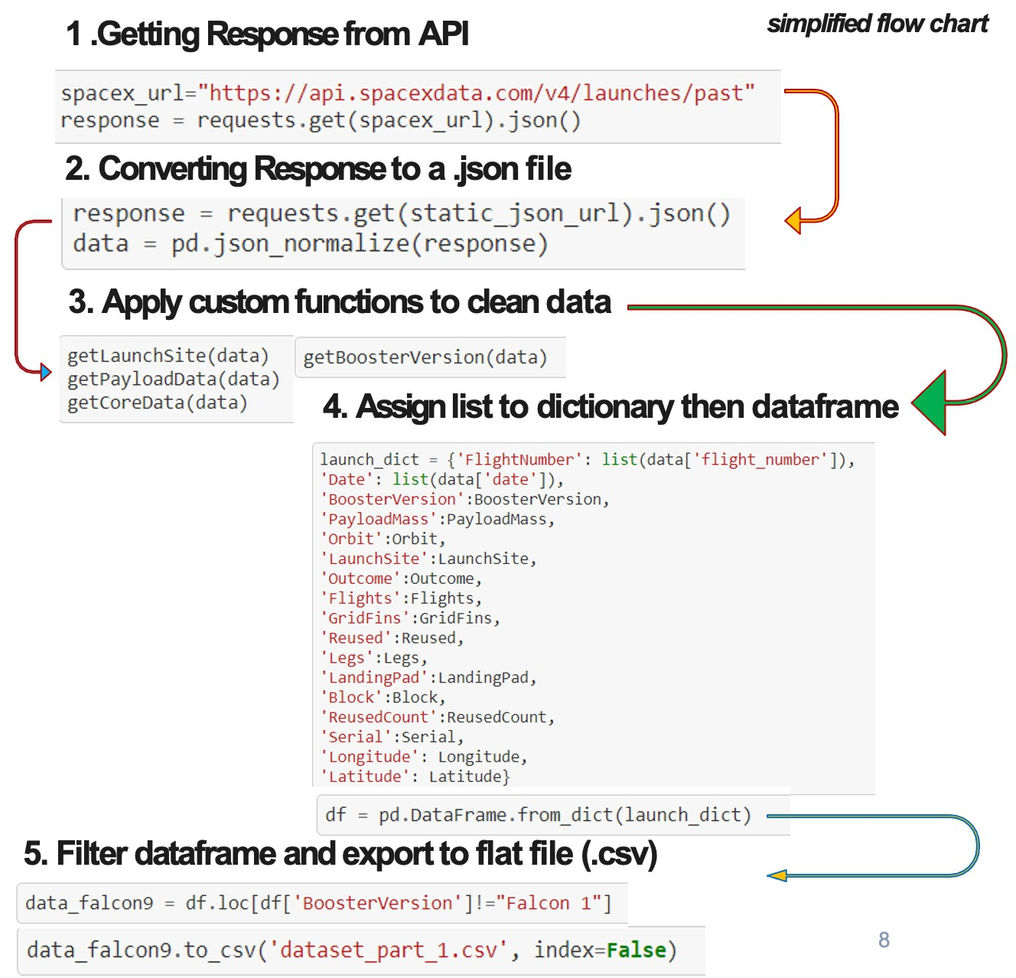
Data Collection – SpaceX API

Slide 9
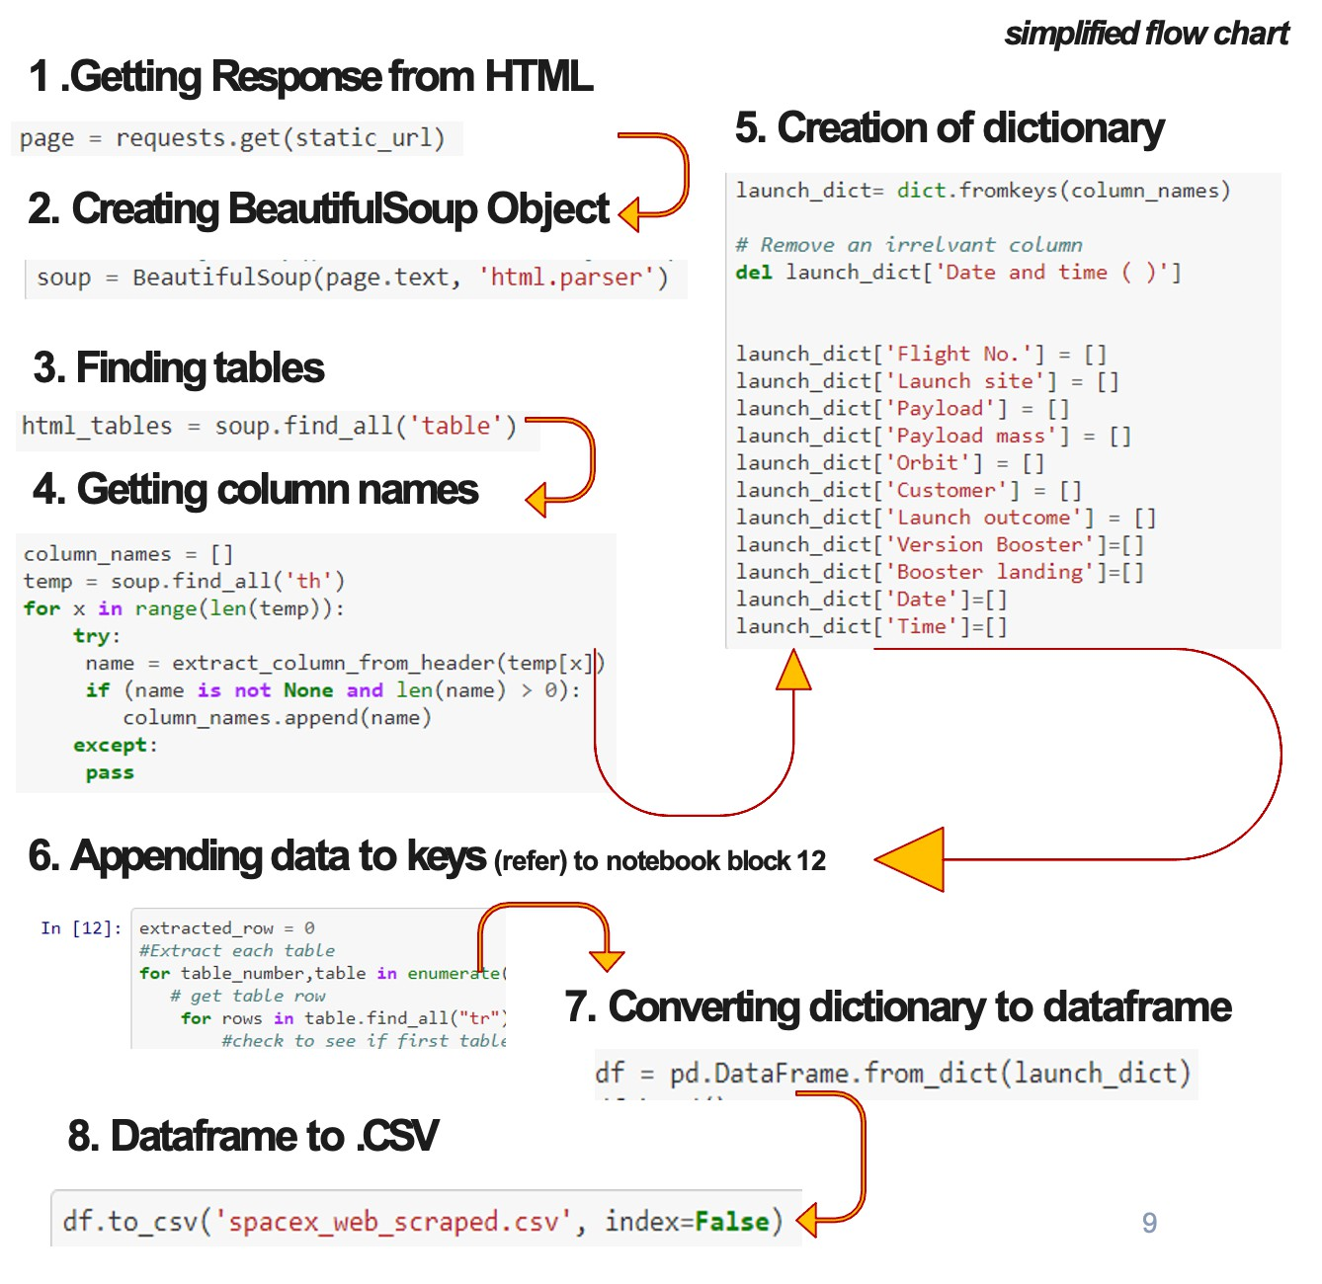
Data Collection - Scraping

Slide 10
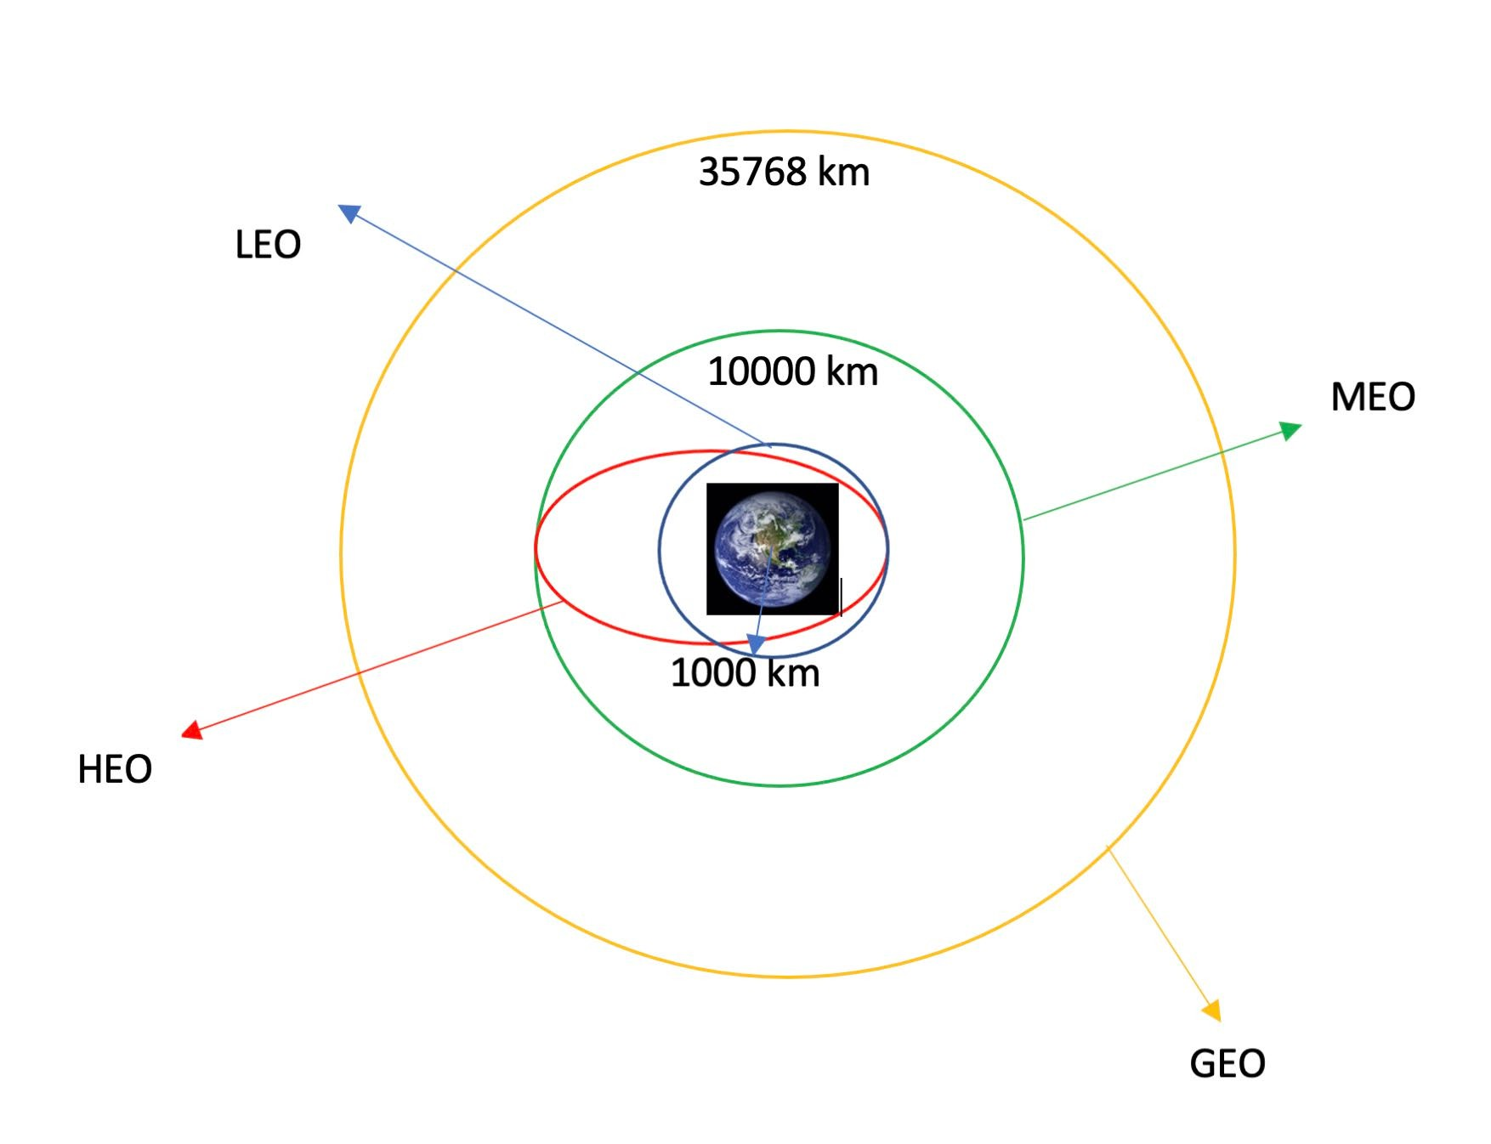
Data Wrangling
Introduction
In the data set, there are several different cases where the booster did not land successfully. Sometimes a landing was attempted but failed due to an accident; for example, True Ocean means the mission outcome was successfully landed to a specific region of the ocean while False Ocean means the mission outcome was unsuccessfully landed to a specific region of the ocean. True RTLS means the mission outcome was successfully landed to a ground pad False RTLS means the mission outcome was unsuccessfully landed to a ground pad.True ASDS means the mission outcome was successfully landed on a drone ship False ASDS means the mission outcome was unsuccessfully landed on a drone ship.
We mainly convert those outcomes into Training Labels with 1 means the booster successfully landed 0 means it was unsuccessful.
Each launch aims to an dedicated orbit, and here are some common orbit types
Process flowcharts
Exploratory Data Analysis
Calculate the number and occurrence of each orbit
Calculate the number of launches on each site
Calculate the number and occurrence of mission outcome per orbit type
Create a landing outcome label from Outcome column& determine success rate
10
Export to CSV

Slide 11

EDA with Data Visualization
Scatterplot:
Scatter plot is a great tool to depict correlation.
FlightNumber vs. PayloadMass
FlightNumber vs LaunchSite
FlightNumber vs Orbit type
Payload vs Launch Site
Payload vs Orbit type
Bar Chart:
Bar chart compares the measure of categorical dimension
Success rate vs 0orbit type
Line Chart:
display trends and developments of numeric data over time.
Launch success yearly trend
11

Slide 12
EDA with SQL
Summary of the SQL queries performed
Display the names of the unique launch sites in the space mission
Display 5 records where launch sites begin with the string 'CCA’
Display the total payload mass carried by boosters launched by NASA (CRS)
Display average payload mass carried by booster version F9 v1.1
List the date when the first succesful landing outcome in ground pad was acheived.
List the names of the boosters which have success in drone ship and have payload mass greater than 4000 but less than 6000
List the total number of successful and failure mission outcomes
List the names of the booster versions which have carried the maximum payload mass
List the records which will display the month names, failure landing_outcomes in drone ship ,booster versions, launch_site for the months in year 2015.
Rank the count of successful landing_outcomes between the date 04-06-2010 and 20-03-2017 in descending order
12

Slide 13
Build an Interactive Map with Folium
Mark all launch sites on an interactive map.
Used latitude and longitude Coordinates of each launch site and added a Circle Marker around each site and a label of the name of the site.
Mark the success/failed launches for each site on the map
assigned the dataframe launch_outcomes(failures, successes) to classes 0 and 1
with Green and Red markers on the map in a MarkerCluster()
Calculate the distances between a launch site to its proximities
Used Haversine’s formula to calculate the distance from the Launch Site to its proximities such as highway, roadway, coastlines. Lines are drawn on the map to measure distance to these proximities.
Example of some trends in which the Launch Site is situated in.
Are launch sites in close proximity to railways? No Are launch sites in close proximity to highways? No Are launch sites in close proximity to coastline? Yes
Do launch sites keep certain distance away from cities? Yes

Slide 14
Build a Dashboard with Plotly Dash
A Plotly Dash application for users to perform interactive visual analytics on SpaceX launch data in real-time
A interactive dashboard allow users to play around and view filtered output.
Graphs
Pie Chart showing the total launches by a specific site/all sites
display relative proportions of multiple classes of data.
size of the circle can be made proportional to the total quantity it represents.
Scatter plot displaying the relationship Payload Mass (Kg) vs Launch Outcome for the different Booster Versions
It shows the correlation.
The range of data i.e. maximum and minimum value, can be filtered

Slide 15
Predictive Analysis (Classification)
BUILDING MODEL
Load our dataset into NumPy and Pandas
Transform Data
Split the dataset into training and test data sets
Check how many test samples we have
Decide which type of machine learning algorithms we want to use
Set our parameters and algorithms to GridSearchCV
Fit our datasets into the GridSearchCV objects and train model with dataset.
EVALUATING MODEL
Check accuracy for each model
Get tuned hyperparameters for each model
Plot Confusion Matrix
FINDING THE BEST PERFORMING CLASSIFICATION MODEL
The model with the best accuracy score wins the best performing model
IMPROVING MODEL
Feature Engineering
Algorithm Tuning

Slide 16
Exploratory data analysis results
Results
Interactive analytics demo in screenshots
Predictive analysis results
16

Slide 17

Section 2

Slide 18
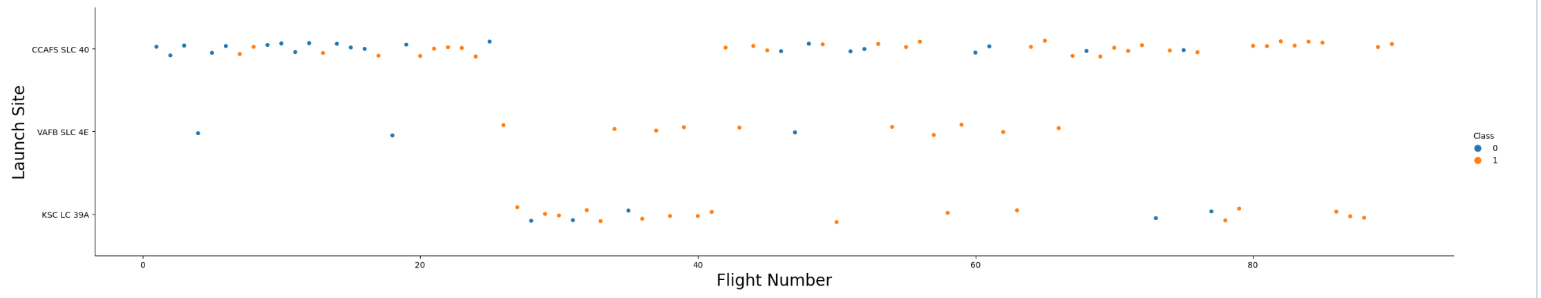
Flight Number vs. Launch Site
The more flights at a launch site the greater the success rate at a launch site.
18

Slide 19
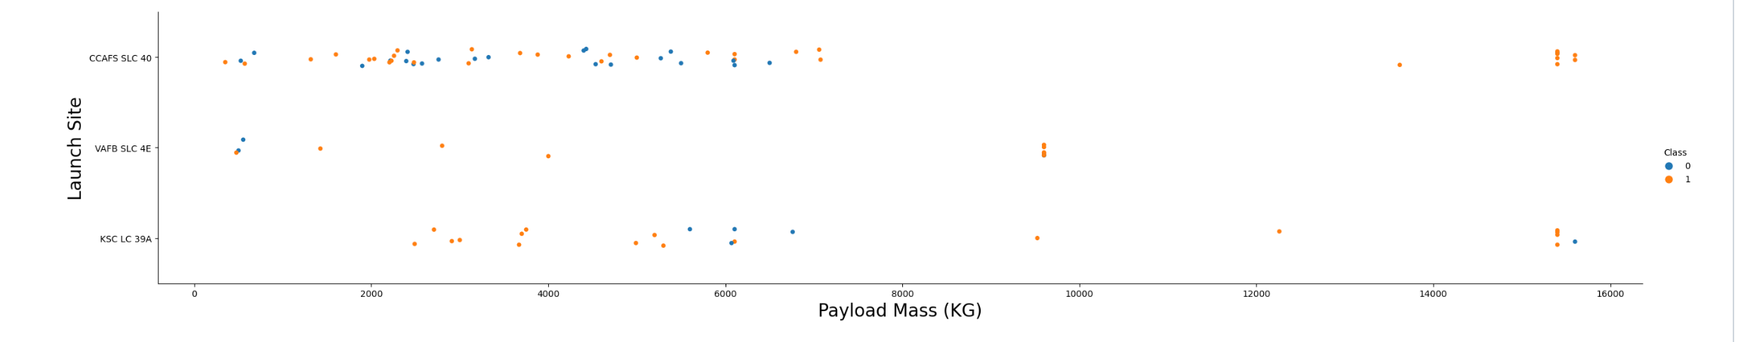
Payload vs. Launch Site
Payload Vs. Launch Site scatter point chart you will find for the VAFB-SLC launch site there are no rockets launched for heavy payload mass(greater than 10000).

Slide 20
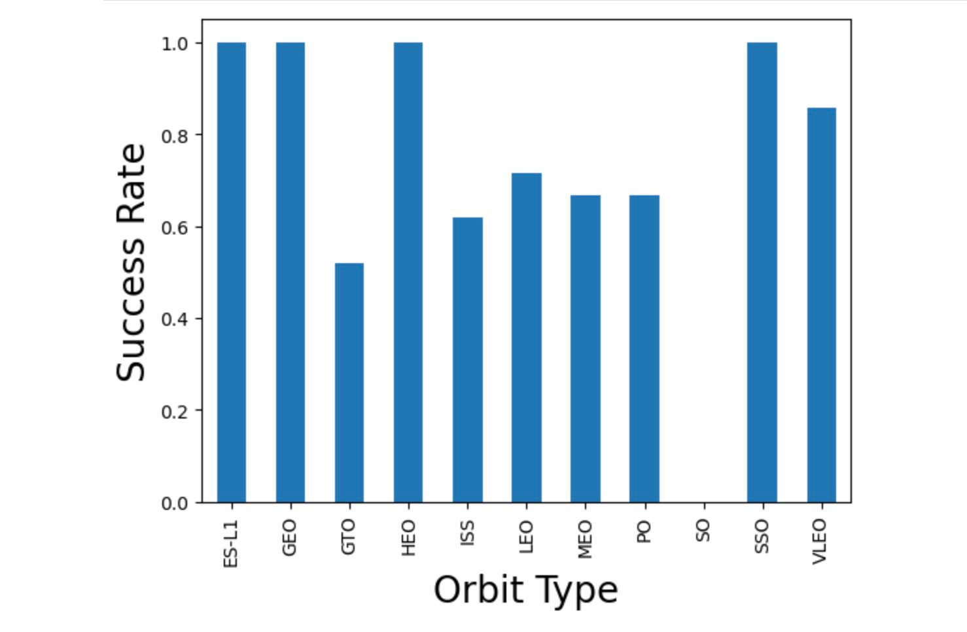
Success Rate vs. Orbit Type
Orbit type GEO,HEO,SSO,ES-L1 have the highest Success Rate

Slide 21
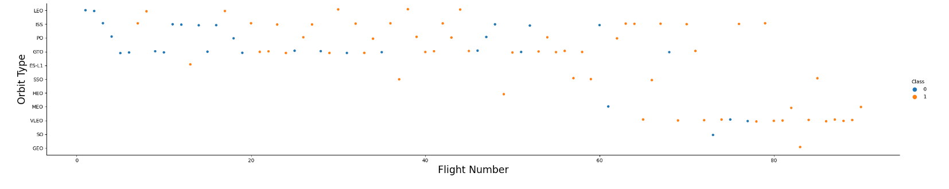
Flight Number vs. Orbit Type
LEO orbit the Success appears related to the number of flights; on the other hand, there seems to be no relationship between flight number when in GTO orbit

Slide 22
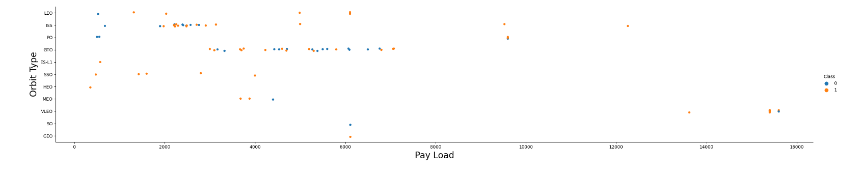
Payload vs. Orbit Type
With heavy payloads the successful landing or positive landing rate are more for Polar, LEO and ISS. However for GTO we cannot distinguish this well as both positive landing rate and negative landing(unsuccessful mission) are both there here
22

Slide 23
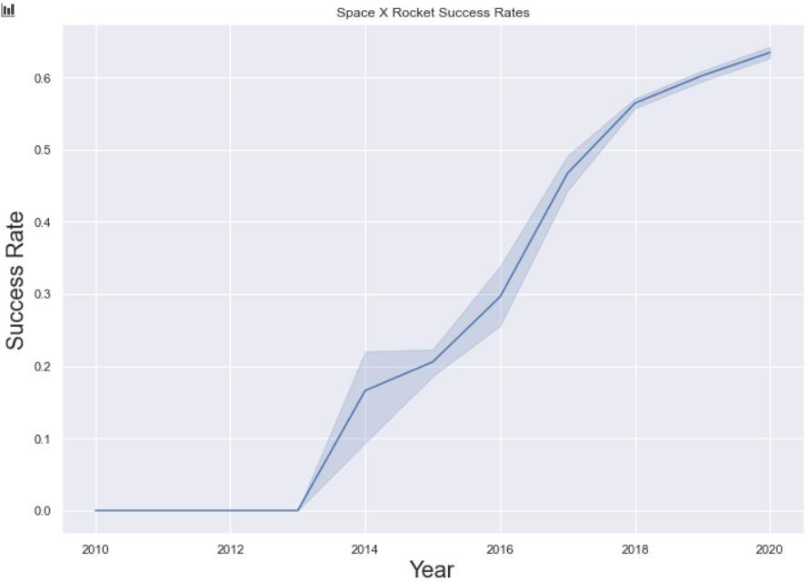
Launch Success Yearly Trend
We can observe that the success rate since 2013 kept increasing
till 2020

Slide 24
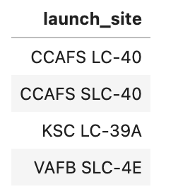
All Launch Site Names
SQL QUERY
SELECT DISTINCT Launch_Site From SPACEXTBL
QUERYEXPLAINATION
Using the word DISTINCT in the query means that it will only show Unique values in the Launch_Site column from SpaceXTBL

Slide 25
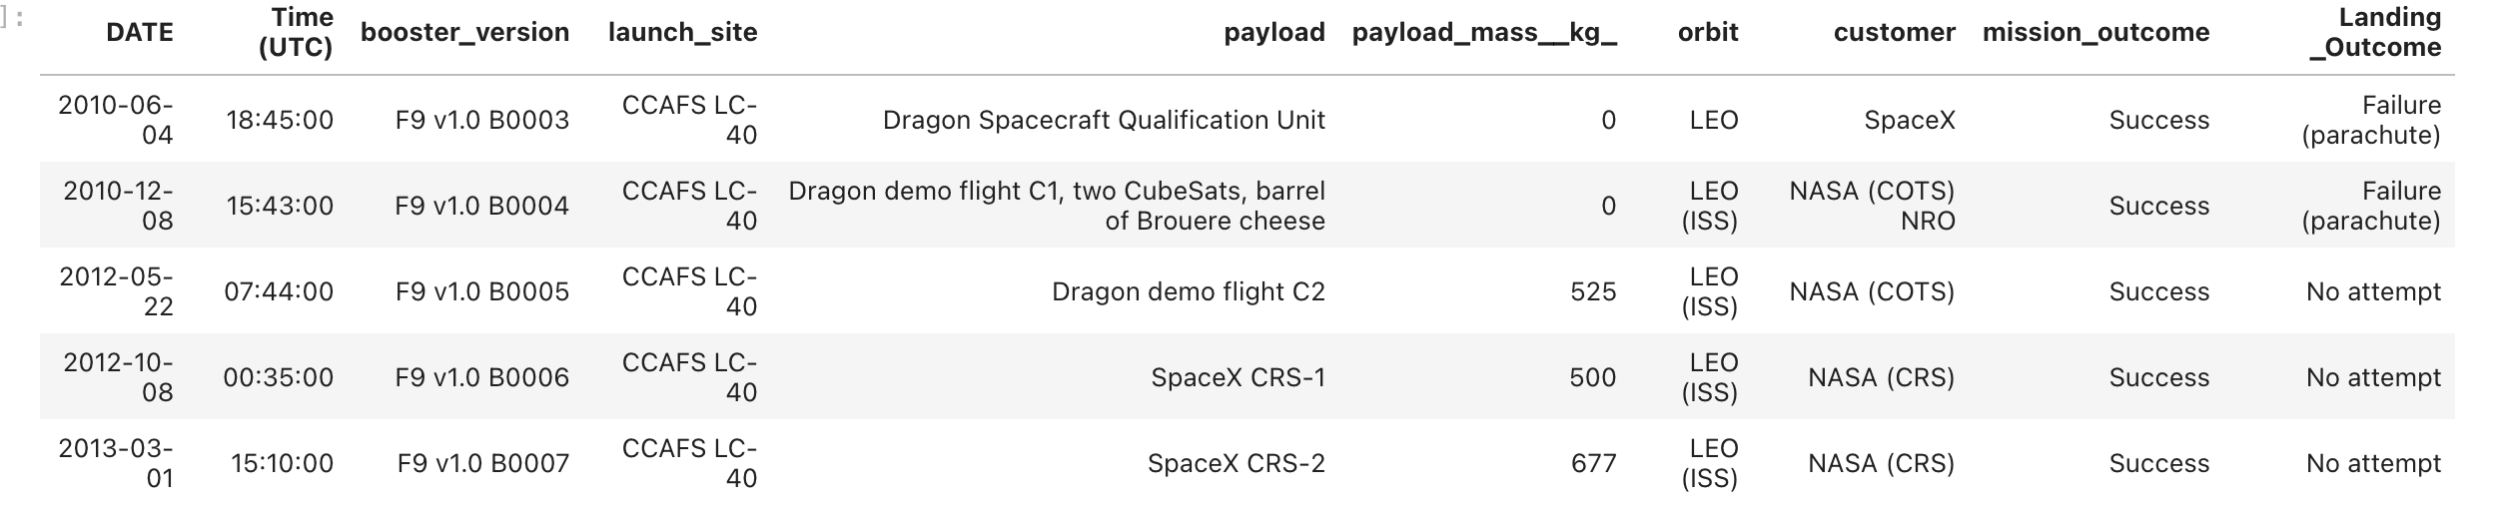
Launch Site Names Begin with 'CCA'
SQL QUERY
SELECT * from SPACEXTBL where (LAUNCH_SITE) LIKE 'CCA%' LIMIT 5
QUERYEXPLAINATION
Using the word limit5 in the query means that it will only show 5 records from SpaceXTBL and LIKE keyword has a wild card to suggest that the Launch_Site name must start with CCA

Slide 26
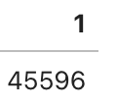
Total Payload Mass
SQL QUERY
SELECT SUM(PAYLOAD_MASS KG_) FROM SPACEXTBL WHERE Customer = 'NASA (CRS)'
QUERYEXPLAINATION
Calculate the total payload carried by boosters from NASA Using the function SUM arrive the the total in the column PAYLOAD_MASS_KG_
The WHERE clause filters the dataset to only perform calculations on Customer NASA(CRS)

Slide 27
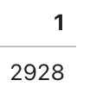
Average Payload Mass by F9 v1.1
SQL QUERY
SELECT AVG(PAYLOAD_MASS KG_) FROM SPACEXTBL WHERE
Booster_Version= 'F9 v1.1'
QUERYEXPLAINATION
Using the function AVGworks out the average in the column
PAYLOAD_MASS_KG_
The WHERE clause filters the dataset to only perform calculations on Booster_version F9 v1.1

Slide 28
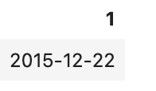
First Successful Ground Landing Date
SQL QUERY
SELECT MIN(Date) FROM SPACEXTBL WHERE Landing_Outcome = 'Success (ground pad)'
QUERYEXPLAINATION
Using the function MIN()works out the minimum date in the column Date
The WHERE clause filters the dataset to only perform calculations on Landing_Outcome Success (ground pad)

Slide 29
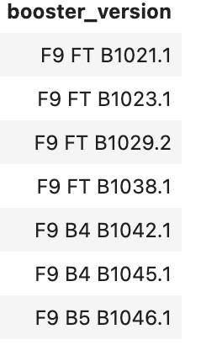
Successful Drone Ship Landing with Payload between 4000 and 6000
SQL QUERY
SELECT BOOSTER_VERSION FROM SPACEXTBL WHERE
"LANDING OUTCOME" = 'Success (drone ship)' AND 4000 < PAYLOAD_MASS <6000
QUERY EXPLAINATION
Selecting Booster_Version Column
The WHERE clause filters the dataset to Landing_Outcome = Success (drone ship)
The AND clause specifies additional filter conditions Payload_MASS_KG_ > 4000 AND Payload_MASS_KG_ < 6000

Slide 30
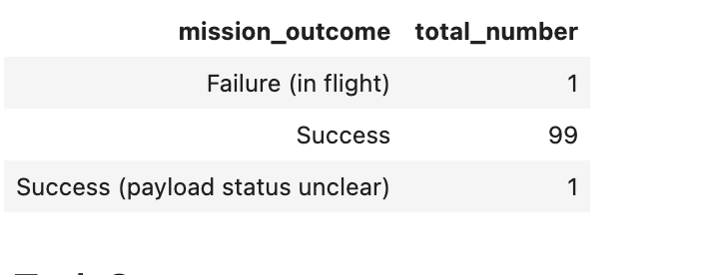
Total Number of Successful and Failure Mission Outcomes
SQL QUERY
SELECT MISSION_OUTCOME, COUNT(MISSION_OUTCOME) AS TOTAL_NUMBER FROM SPACEXTBL GROUP BY MISSION_OUTCOME
Query Explanation:
Select Mission_Outcome column,
Count() to get the total number of each mission outcome Group by to summarize the results.

Slide 31
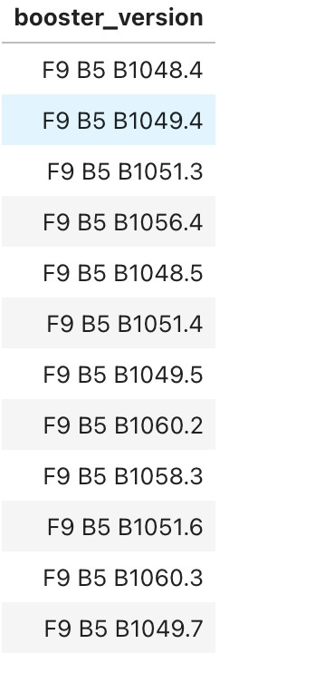
Boosters Carried Maximum Payload
SQL QUERY
SELECT DISTINCT BOOSTER_VERSION FROM SPACEXTBL
WHERE PAYLOAD_MASS KG_ =
(SELECT MAX(PAYLOAD_MASS KG_) FROM SPACEXTBL
QUERY EXPLAINATION
Using the word DISTINCT in the query means that it will only show Unique values in the Booster_Version column from SPACEXTBL
SUBQUERY in th e where Clause filtered the result to a certain condition maximum payload.
31

Slide 32
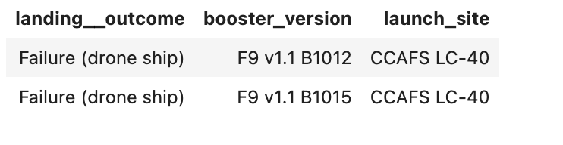
2015 Launch Records
QUERY EXPLAINATION
SQL QUERY
SELECT LANDING OUTCOME, BOOSTER_VERSION, LAUNCH_SITE
FROM SPACEXTBL WHERE Landing_Outcome = 'Failure (drone ship)' AND YEAR(DATE) = 2015
WHERE and AND clause filtered the result to 2 conditions “Landing_Outcome = 'Failure (drone ship)” and in 2015.

Slide 33
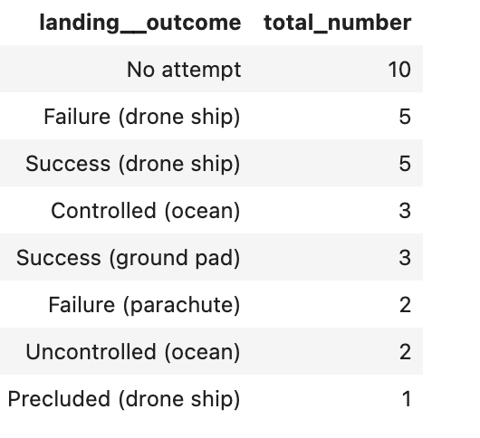
Rank Landing Outcomes Between 2010-06-04 and 2017-03-20
SQL QUERY
SELECT LANDING OUTCOME, COUNT(LANDING OUTCOME) AS TOTAL_NUMBER FROM SPACEXTBL WHERE DATE
BETWEEN '2010-06-04' AND '2017-03-20' GROUP BY LANDING OUTCOME ORDER BY TOTAL_NUMBER DESC
QUERY EXPLAINATION
Count() count the total “landing_outcome” column
WHERE and AND clauses filtered the result by 2 conditions. Group by to summarize the data with landing_outcome. Order by rank the data.

Slide 34

Section 3

Slide 35
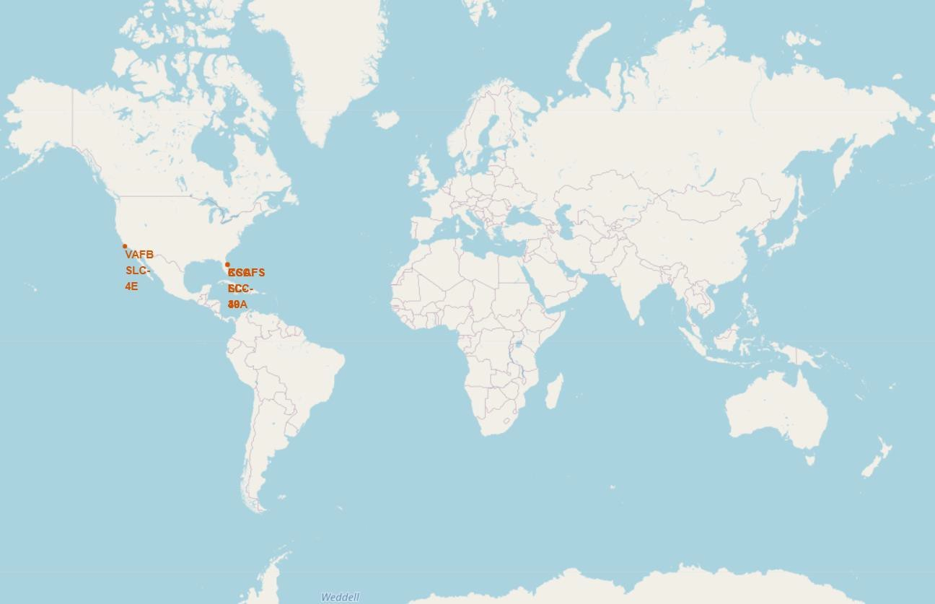
All launch sites global map markers
We can see that the SpaceX launch sites are in the United States of America coasts. Florida and California
35

Slide 36
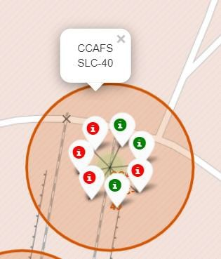
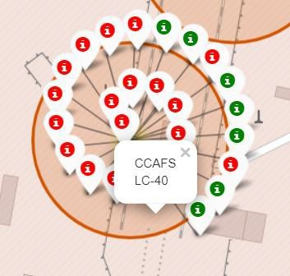
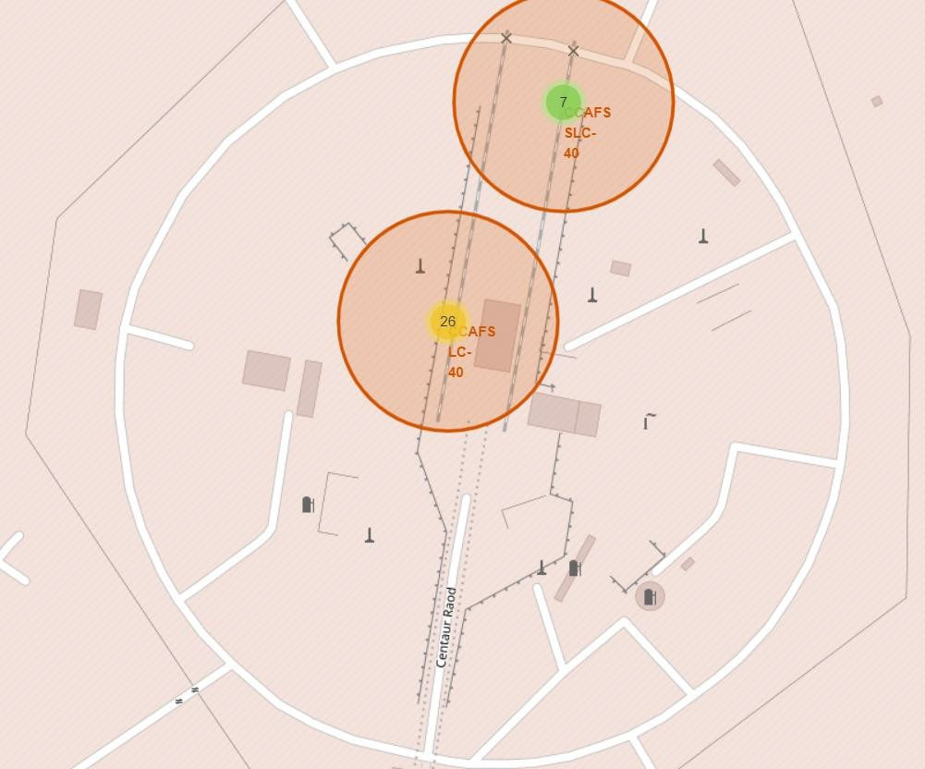
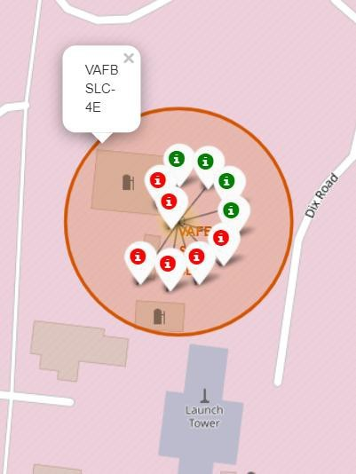
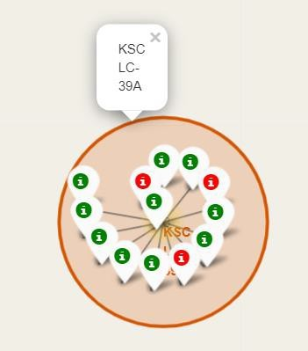
Colour Labelled Markers
California Launch Site
Florida Launch Sites
Green Marker shows successful Launches and Red Marker shows Failures
36
37

Slide 37
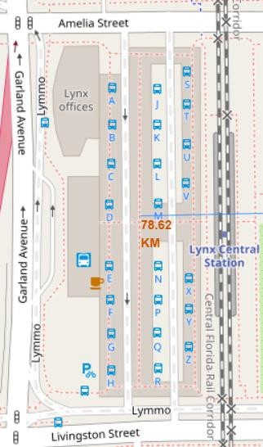
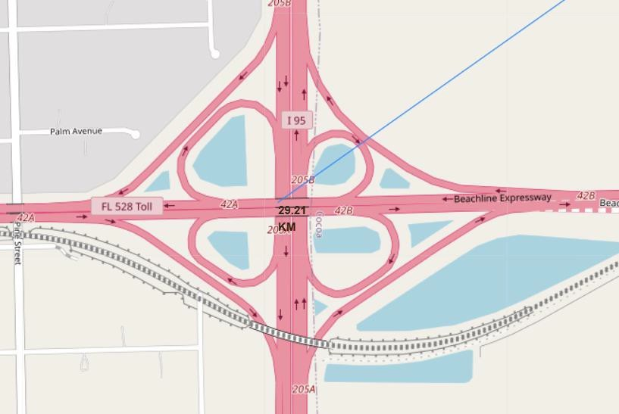
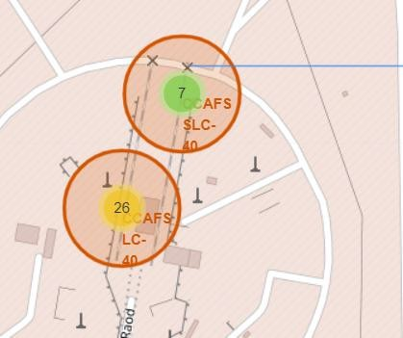
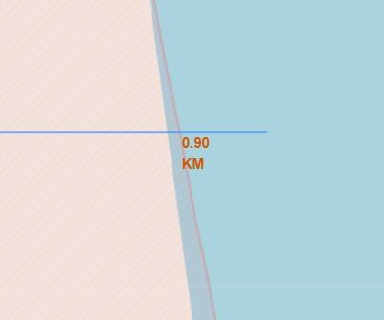
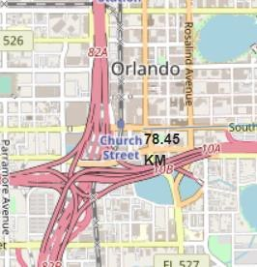
Launch Sites distance to landmarks its proximities
Distance to closest Highway
Distance to coast
Are launch sites in close proximityto railways? No
Are launch sites in close proximityto highways? No
Are launchsites in closeproximity to coastline? Yes
Do launch sites keep certain distance awayfrom cities? Yes
Distance to Railway Station
Distance to Coastline
Distance to City
37

Slide 38

Section 4

Slide 39
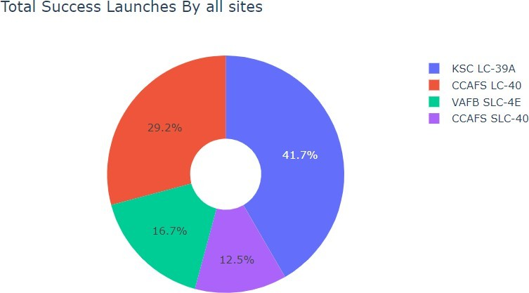
DASHBOARD– Piechart Total Success by each launch site
We can see that KSCLC-39A had the
most successful launches from all the sites

Slide 40
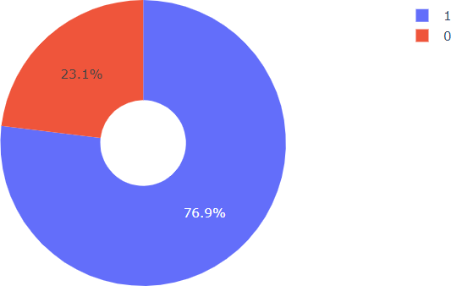
DASHBOARD–Piechart for launch site with the highest launchsuccessratio
KSCLC-39A achieved a 76.9% success rate while getting a 23.1% failure rate

Slide 41
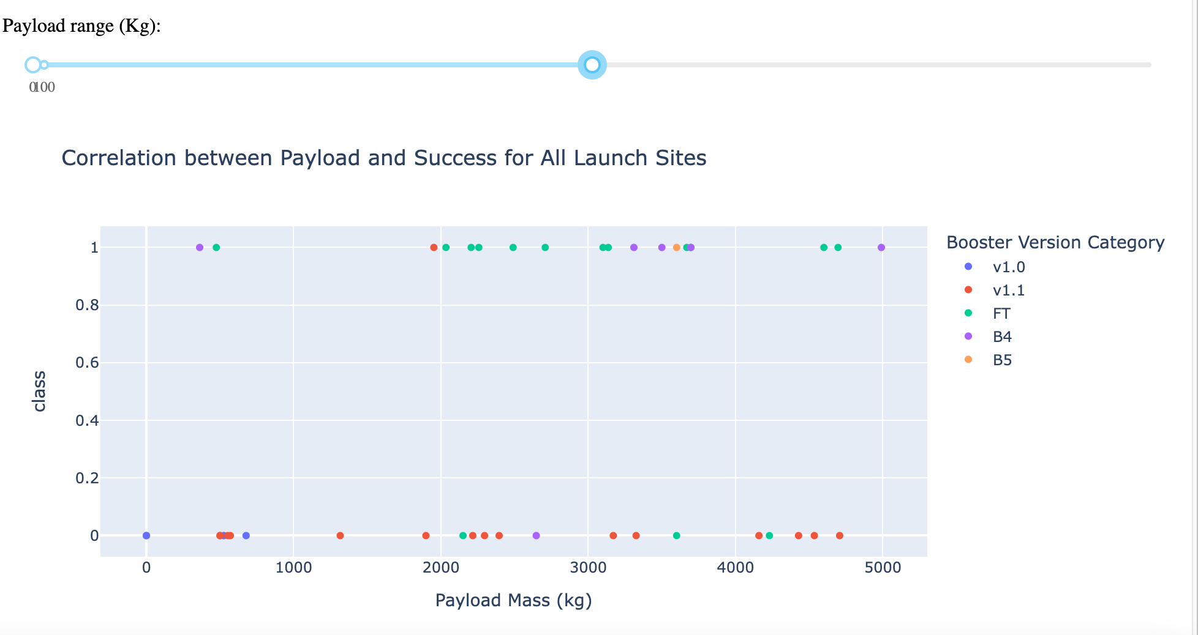
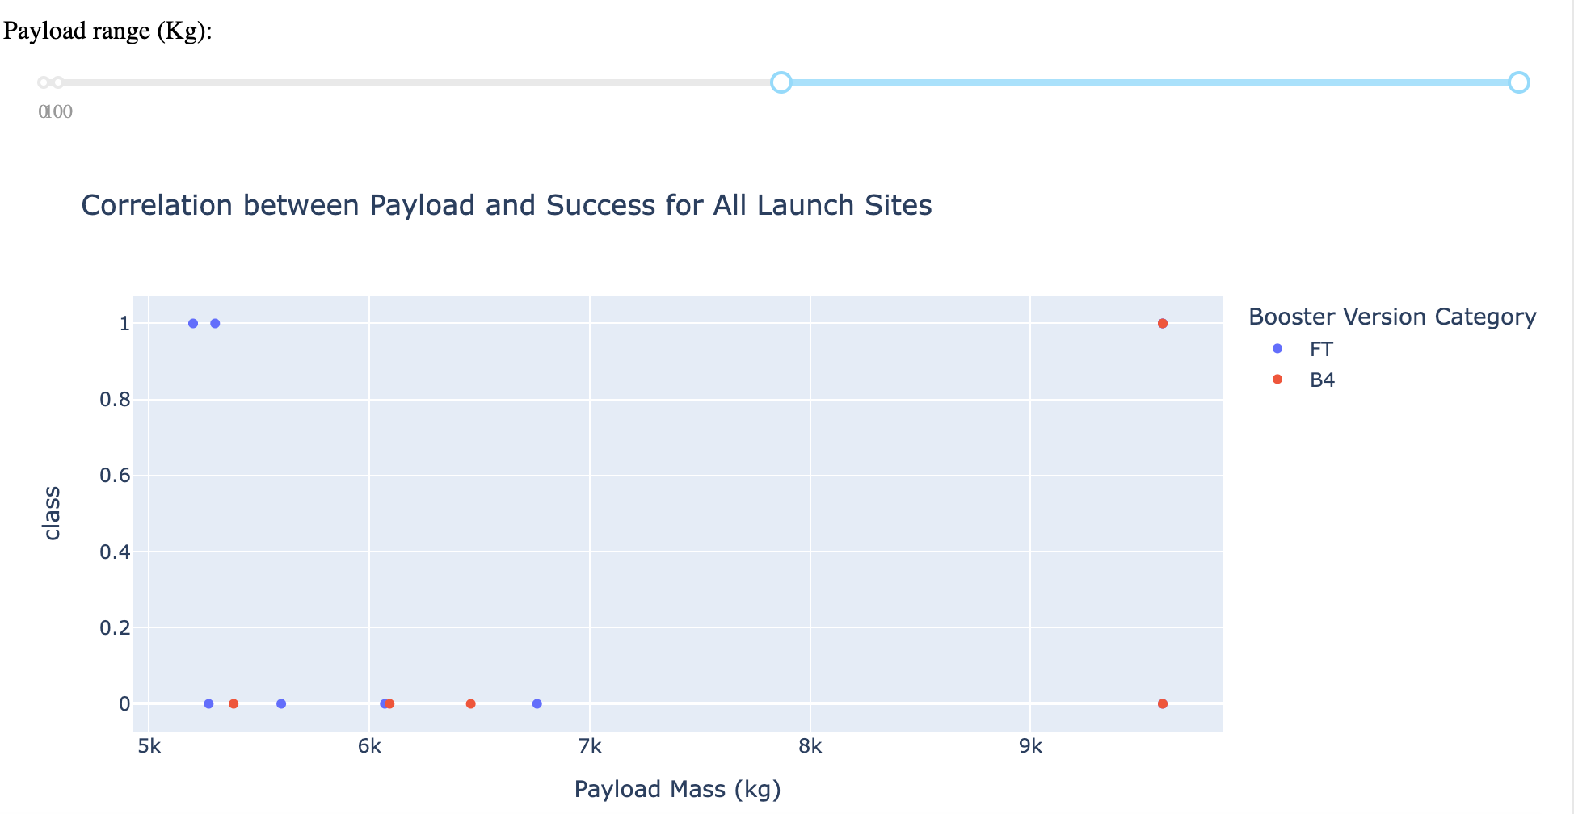
DASHBOARD–Payloadvs.LaunchOutcomescatterplot for all sites,with different payloadselectedin the rangeslider
Low Weighted Payload 0kg – 5000kg
Heavy Weighted Payload 5000kg – 10000kg
We can see the success rates for low weighted payloads is higher than the heavy weighted payloads
41

Slide 42

Section 5

Slide 43
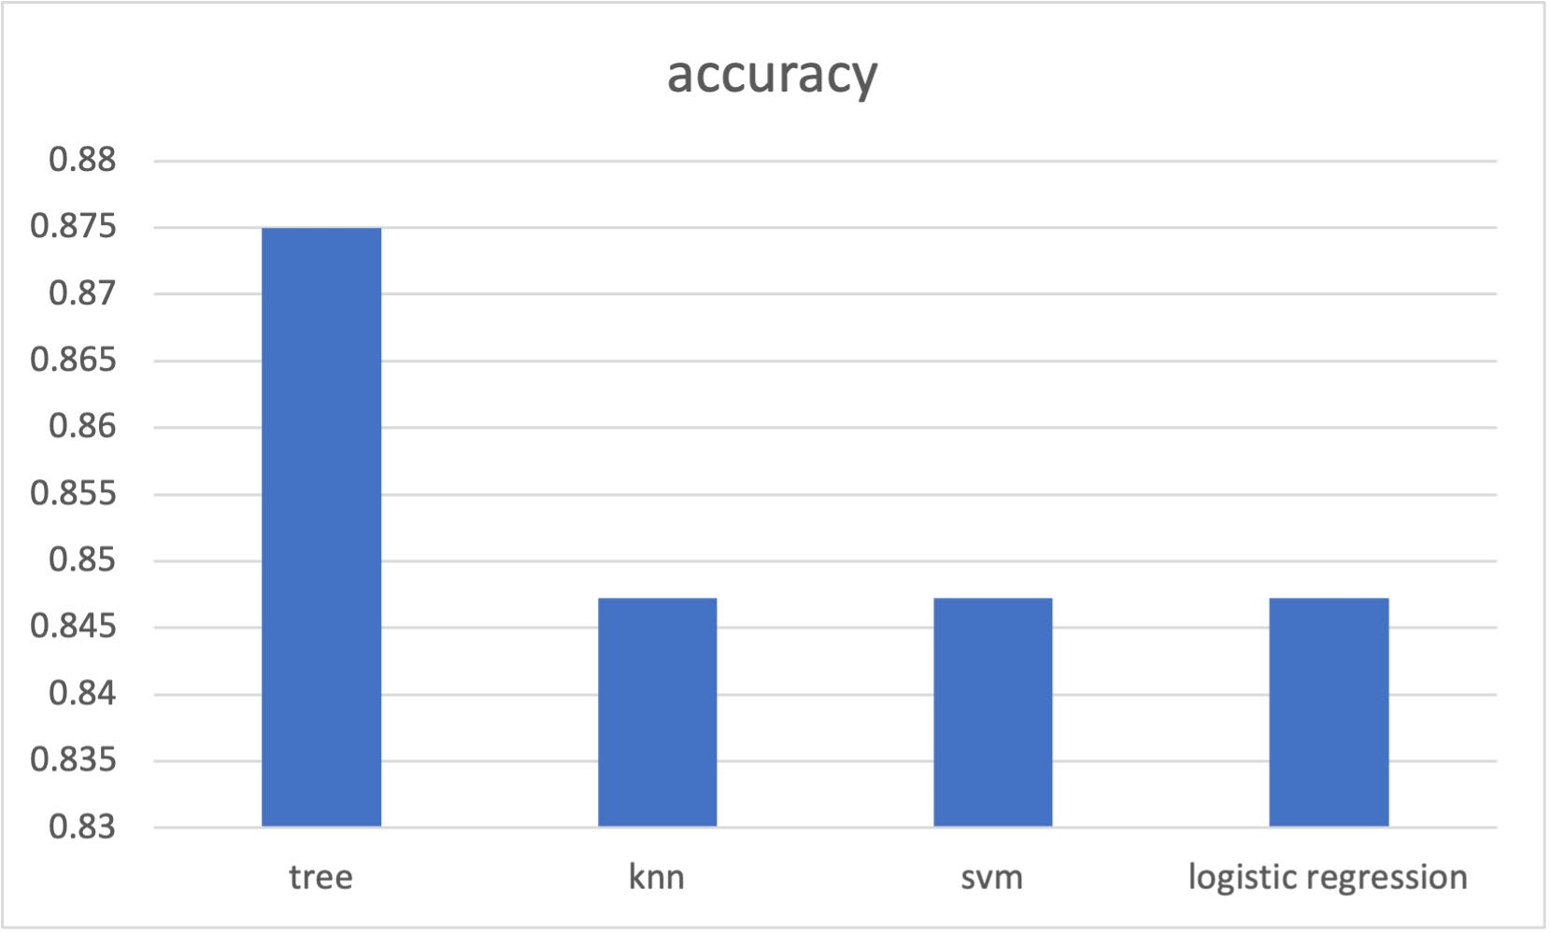
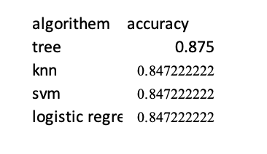
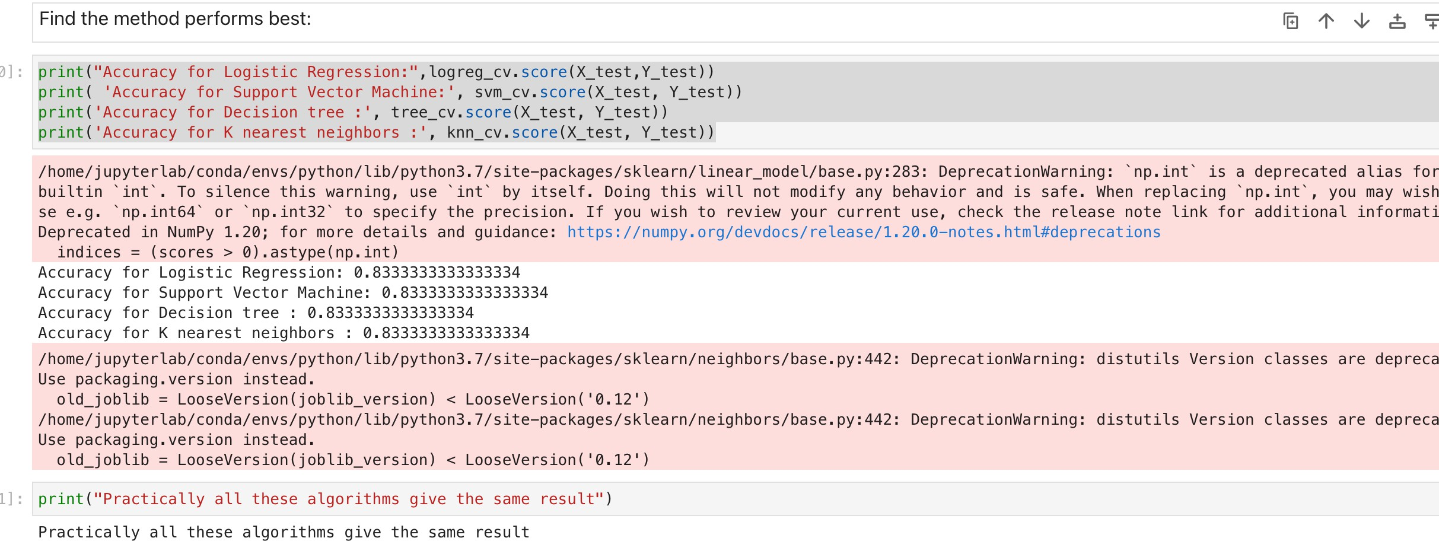
Classification Accuracy
As you can see our accuracy is extremely close and Tree Algorithm slightly higher accuracy
we achieved 83.33% accuracy on the test data.

Slide 44
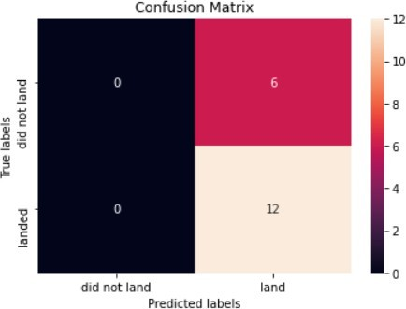
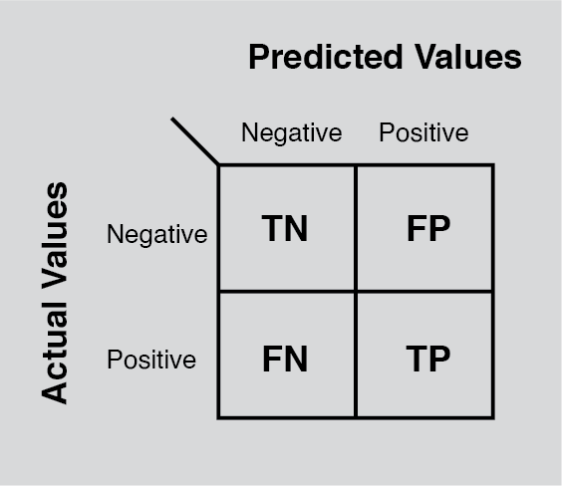
Confusion Matrix
Examining the confusion matrix, we seethat Treecan distinguish between the different classes. We see that themajorproblemis false positives.

Slide 45
Conclusions
The Tree Classifier Algorithm is the slightly better for Machine Learning for training dataset, all model perform 83% accuracy on test data.
Low weighted payloads perform better than the heavier payloads
The success rates for SpaceX launches is directly proportional time in years they will eventually perfect the launches
We can see that KSCLC-39A had the most successful launches from all the sites
Orbit type GEO,HEO,SSO,ES-L1 has the best SuccessRate

Slide 46
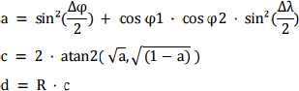
Appendix
Haversine formula is used in Folium map calculating distances
Introduction
The haversineformuladeterminesthe great-circle distancebetweentwo points on a spheregiventheir longitudesandlatitudes.Importantin navigation,it is a specialcase ofa moregeneralformulain sphericaltrigonometry,the law of haversines,thatrelatesthe sides andanglesof sphericaltriangles.
Usage
WhydidI usethisformula?First ofall,I believethe Earthisround/elliptical.I amnot a FlatEarth Believer!Jokes asidewhen doing Googleresearchforintegratingmy ADGGoogleMapsAPI witha Pythonfunction to calculatethe distanceusing two distinctsets of {longitudinal,latitudinal}listsets. Haversinewas the trigonometricsolution to solve my requirementsabove.
Formula

Slide 47


